Slide 1

PBEL PROJECT
LED BLINKING CIRCUIT
IOT 23 JUNE BATCH-1
INTERN’S NAME:- CHANDRA BAHADUR
YADAV TRAINER’S NAME:- MR.PRITHVIRAJ SINGH
RATHORE

Slide 2
Objective of the Project
To design a smart LED blinking and alert system based on multiple sensor inputs.
Provide real-time alerts using LEDs, buzzer, and LCD.
Display critical sensor values and warnings instantly.
Prioritize alerts such as gas leakage, abnormal temperature, proximity, and motion.

Slide 3
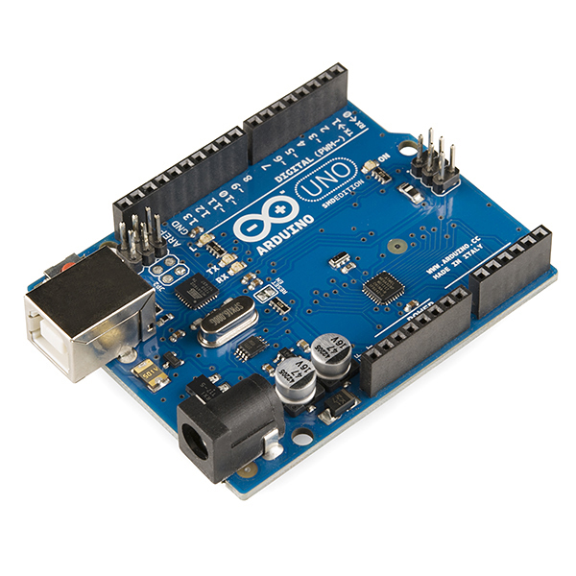
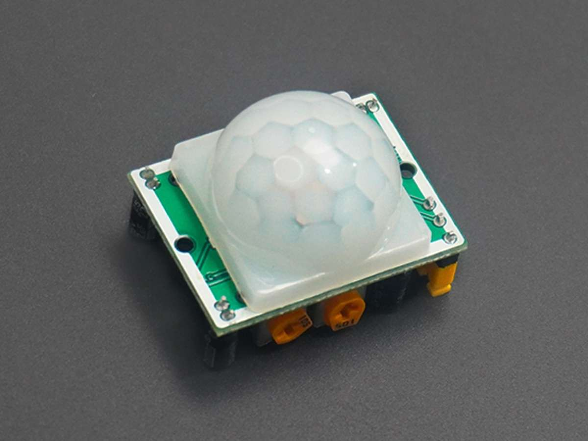
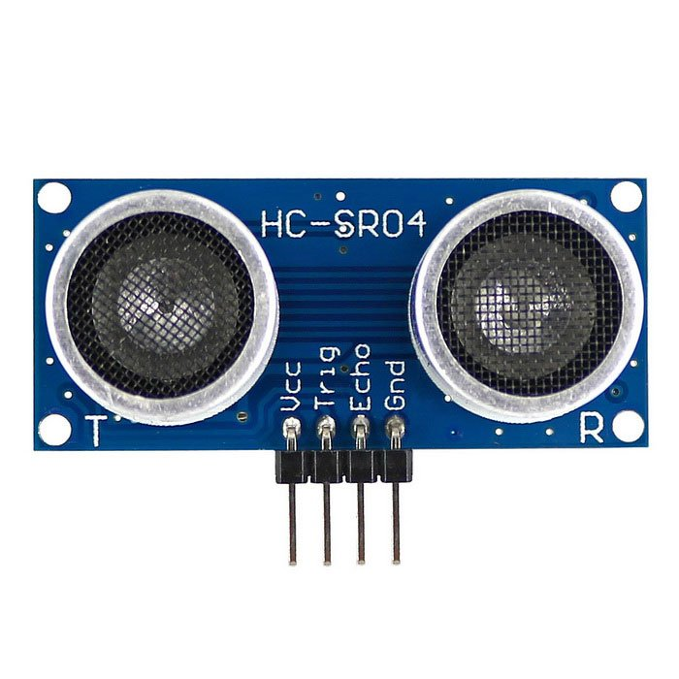
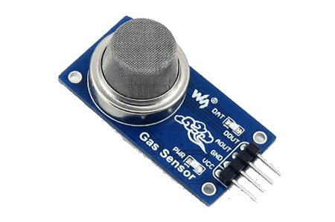
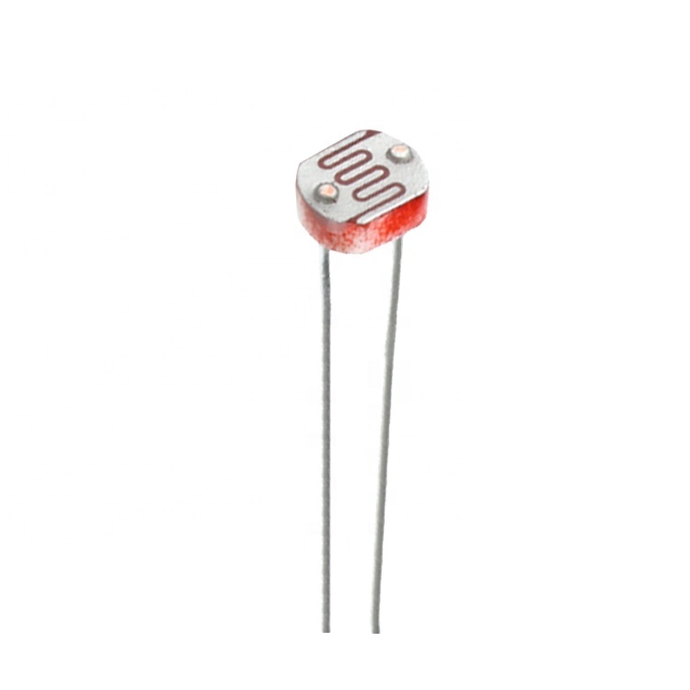
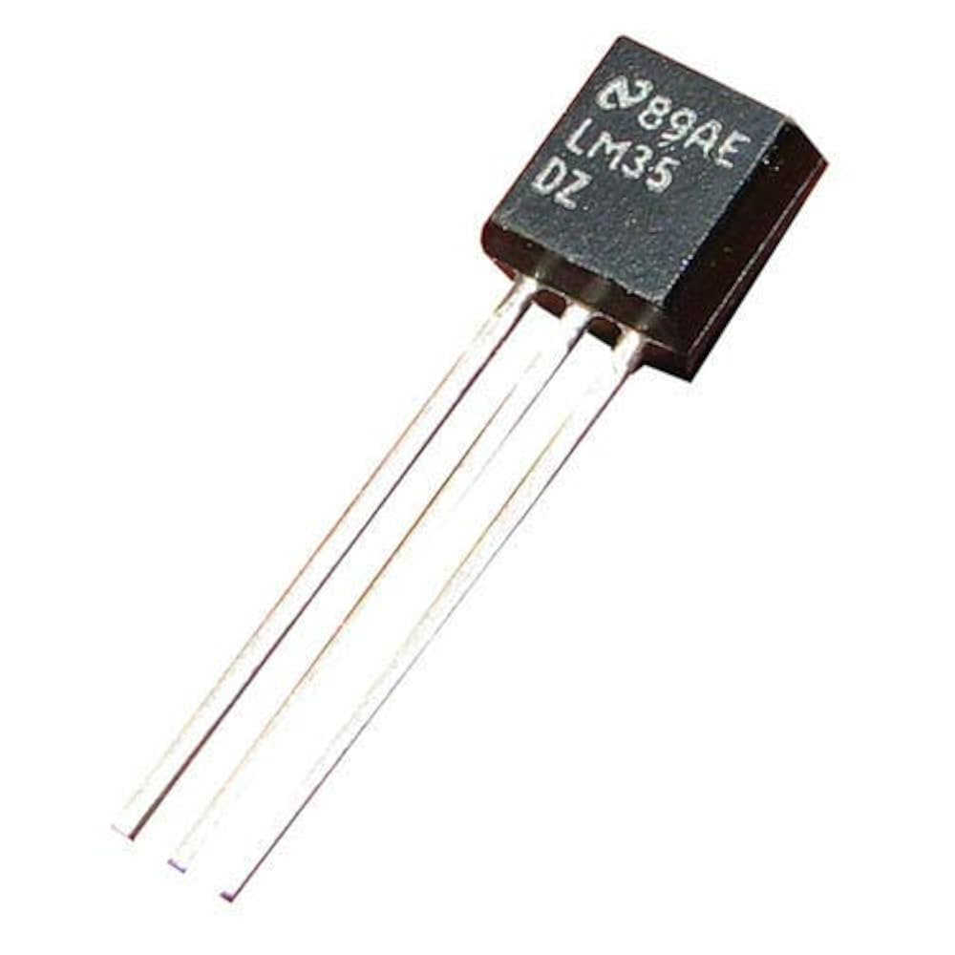
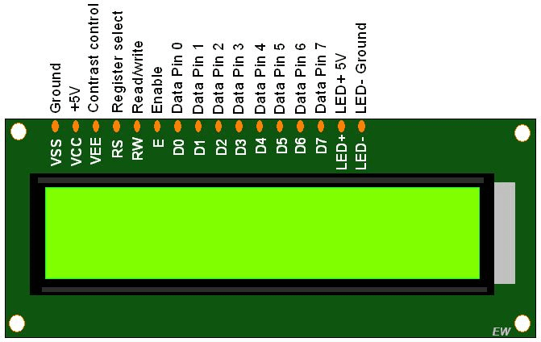

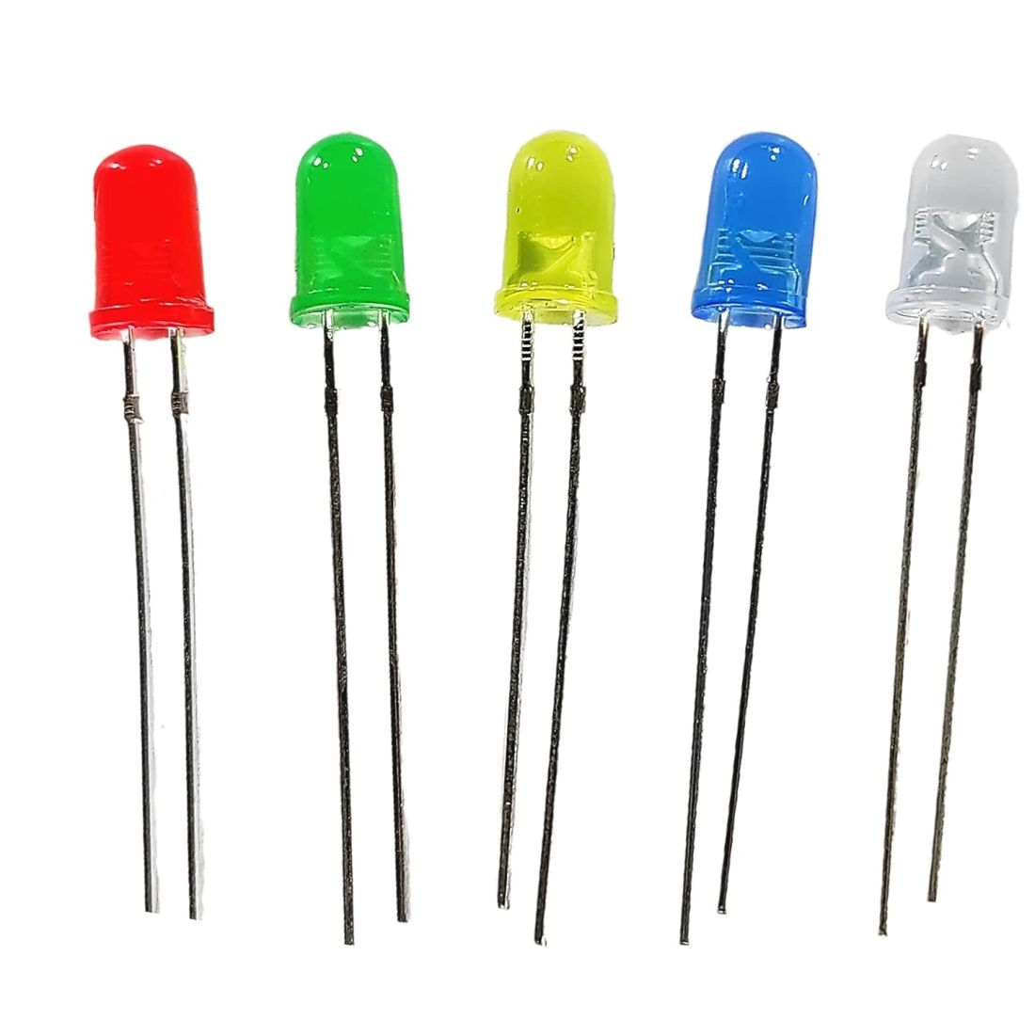
Components Used
Arduino UNO
PIR Motion Sensor
Ultrasonic Sensor (HC-SR04)
Gas Sensor (MQ-2 or MQ-135)
Temperature Sensor (NTC Thermistor or LM35)
LDR (Photoresistor)
16x2 LCD with I2C or standard 6-pin control
Buzzer
5 LEDs (for each sensor output)
Breadboard, jumper wires, resistors (220 Ohm)
1
2
3
4
5
6
7
8
9

Slide 4
Working Principle
Each sensor monitors a physical condition:
PIR: Detects motion and blinks LED fast if active.
Ultrasonic: Measures object distance and warns through buzzer while blinking LED if too close.
Gas Sensor: Detects air quality; triggers alert on leak with LED blink .
Temperature Sensor: Triggers high/low temp warning with LED blink.
LDR: Adjusts LED brightness based on light intensity.
LCD shows current status or warnings instantly.
Buzzer beeps on close-range detection.

Slide 5
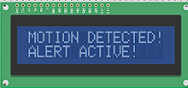

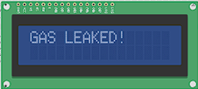
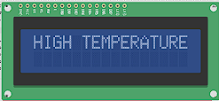
Alert Prioritization and Display Logic
Top Priority Alerts (interrupt display):
Gas leakage (gas > 300)
High Temp (>100) or Low Temp (<10)
Close Object (<30cm)
Motion Detected (recent < 2 sec)
Rotating Info (when no alert):
Motion & Light %
Distance & Gas
Temperature & Status
Each state shown for 3 seconds.

Slide 6
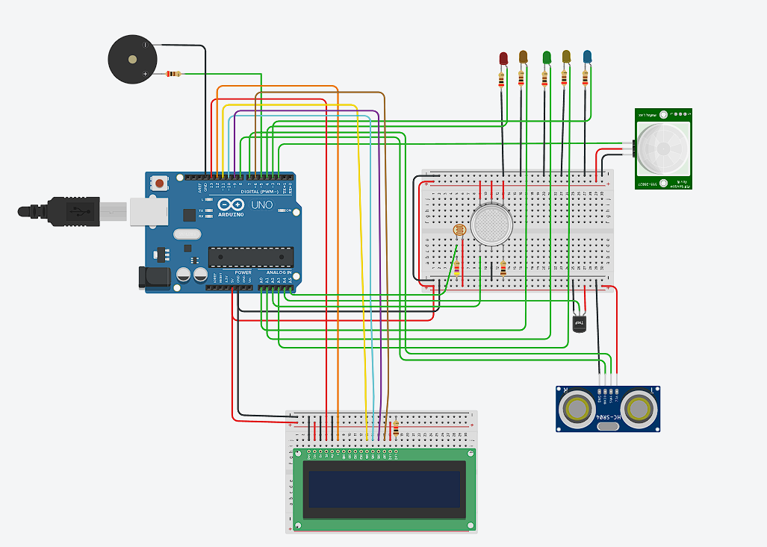
Circuit diagram
https://www.tinkercad.com/things/hcEEnle9sTO-shiny-gogo-kieran/editel?returnTo=https%3A%2F%2Fwww.tinkercad.com%2Fdashboard&sharecode=zJtR6eIrVjWQGw2iuXpHos8twHCn_zH23Q3xkj6rzE0

Slide 7
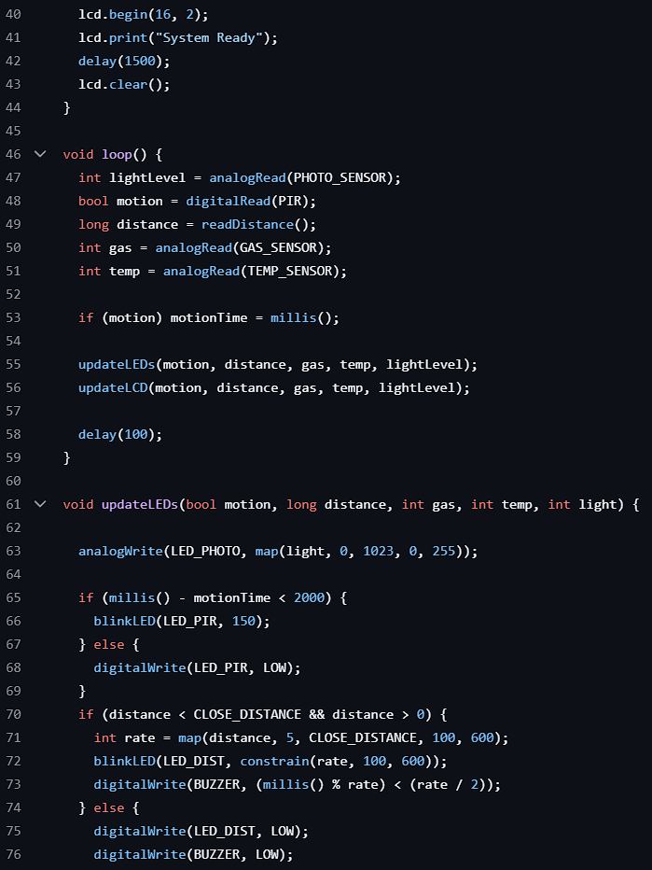
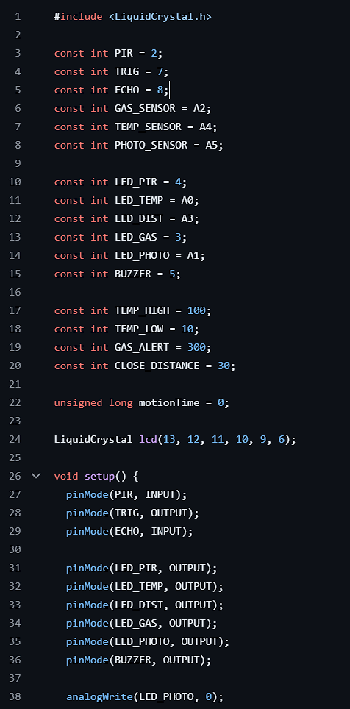
ARDUINO CODE:-

Slide 8

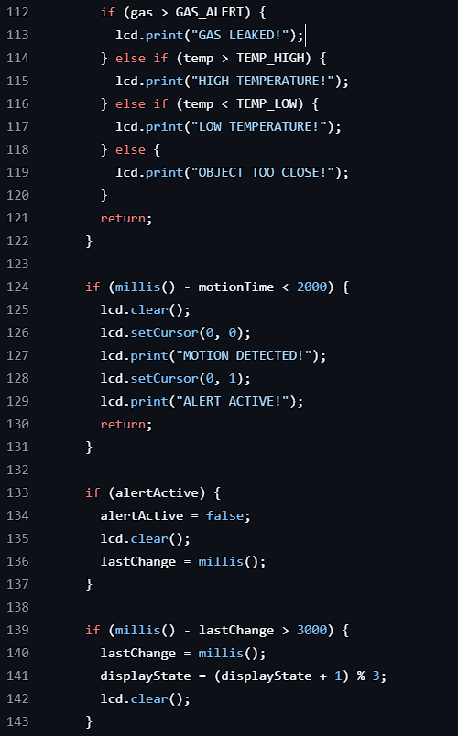

Slide 9
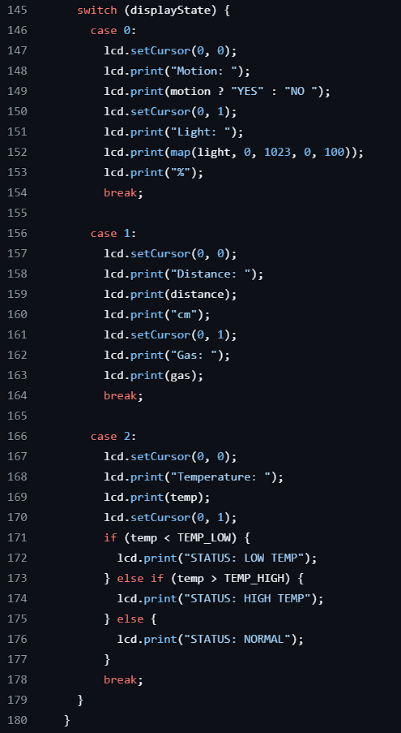


Slide 10
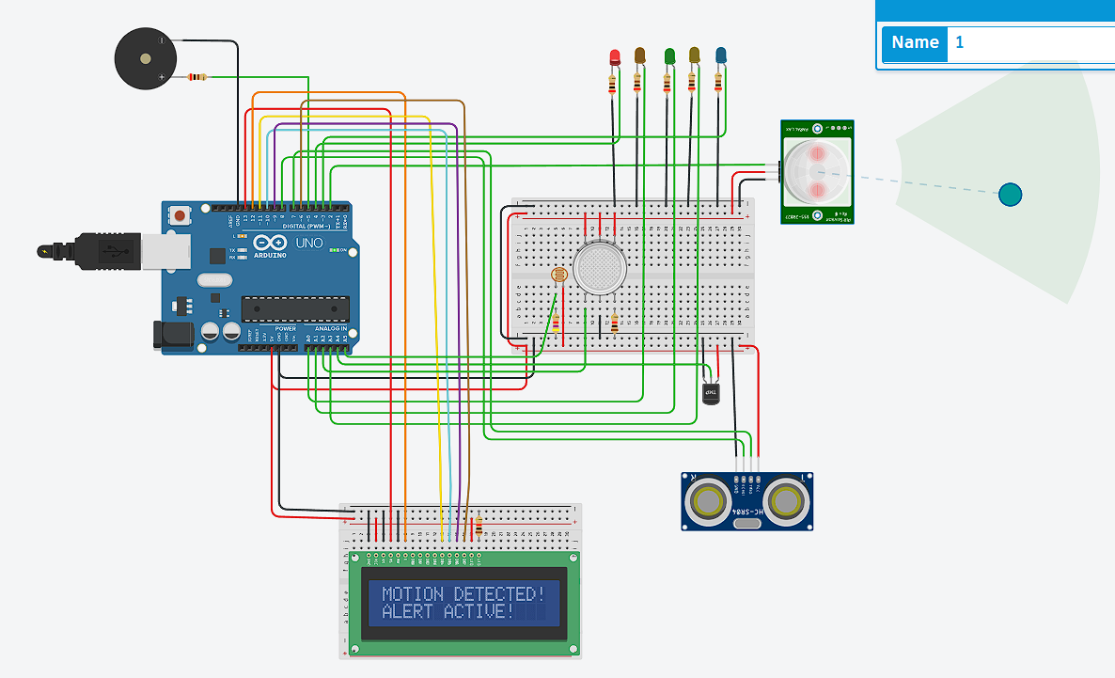
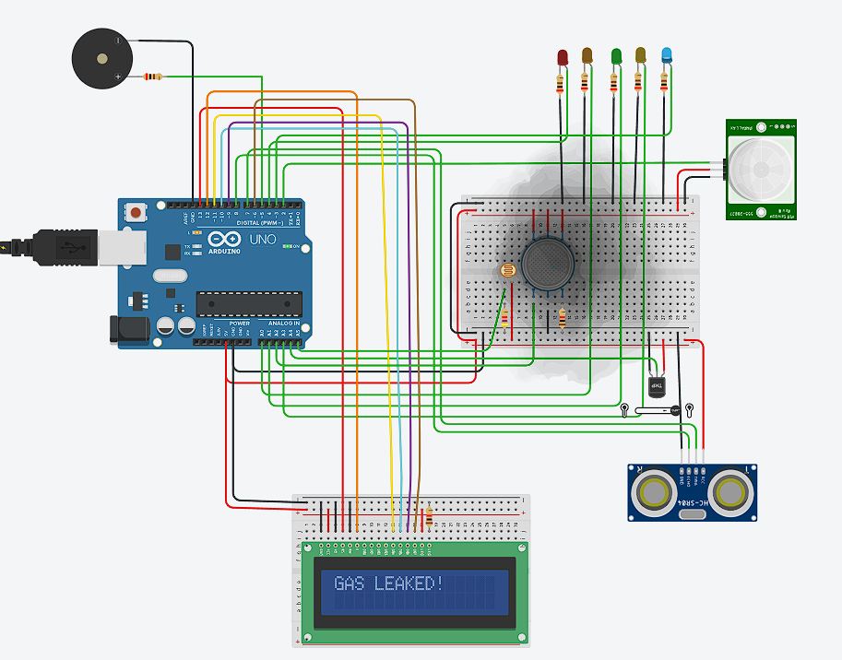
Output:- (After Simulation)
Motion sensor + “RED LED”
Gas sensor + “BLUE LED”

Slide 11
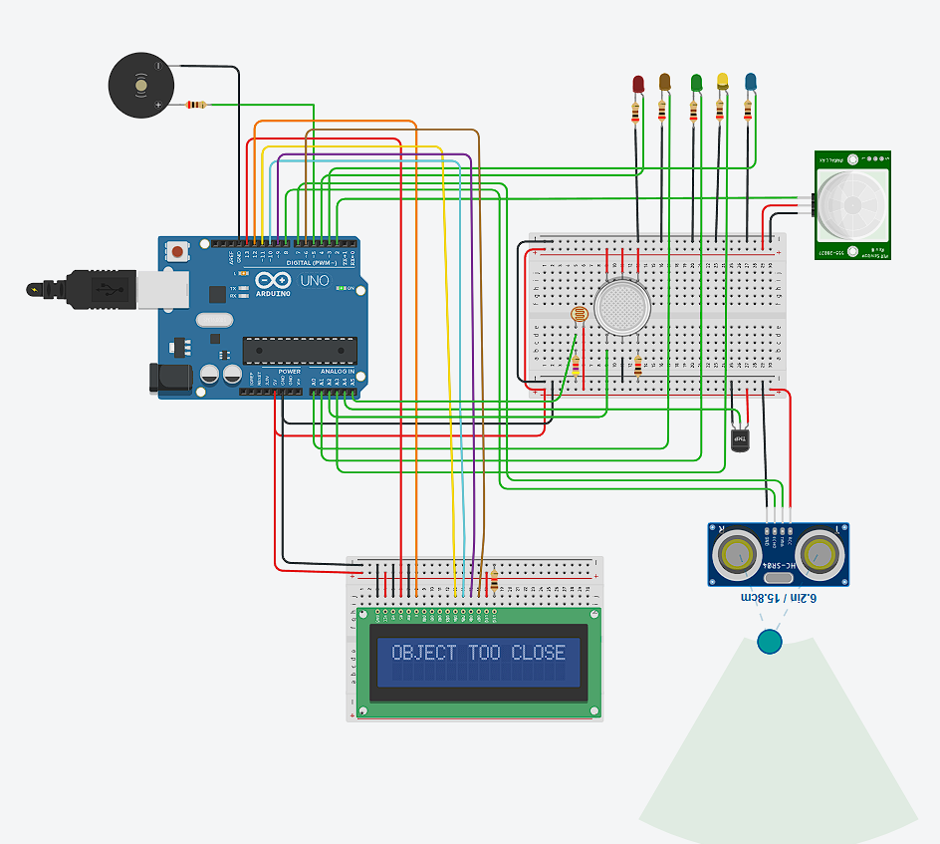
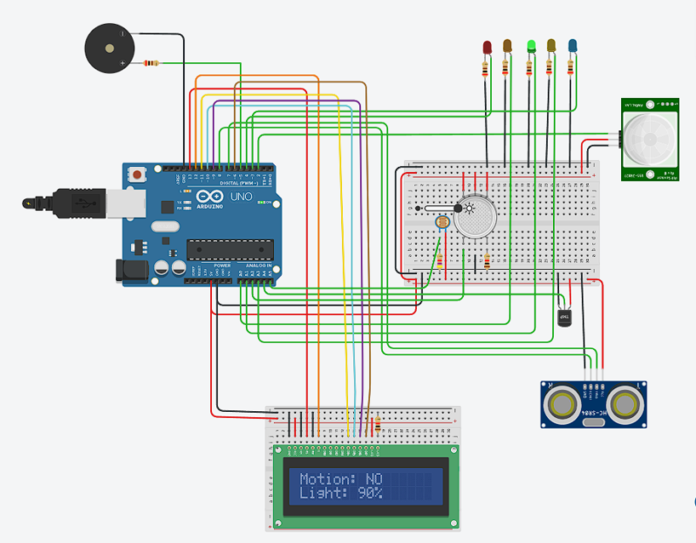
LDR sensor + “GREEN LED”
Ultrasonic sensor + “YELLOW LED”

Slide 12
Conclusion
This project successfully demonstrates a smart multi-sensor LED BLINKING reactive system using Arduino. It effectively utilizes motion, gas, temperature, distance, and light sensors to control multiple LEDs, a buzzer, and an LCD for real-time alerts. The system prioritizes safety by instantly alerting in case of gas leakage, abnormal temperature, proximity breach, or sudden motion, with clear blinking patterns and messages. The logic adapts dynamically based on sensor input severity and LED blinking output, making it a powerful educational and prototype LED BLINKING with sensor model.
CHALLENEGES FACED:-
Limited analog pins on Arduino UNO required careful mapping.
LED blinking rate control without blocking code (used millis() instead of delay()).
Avoiding sensor conflicts and false positives (especially with PIR).
LCD updates needed to prioritize urgent data but still allow info rotation.

Slide 13


